Slide 1
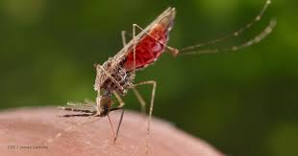
C7083 – Mini-project
Global Malaria dataset – hosted by Wellcome Trust
Three datasets
Selected Malaria Deaths set
Malaria deaths by country for all ages across the world and time.
Dictionary
Entity : country name
Code : 3 letter code for country (link variable)
Year : 1990 - 2016
Deaths - Malaria - Sex: Both - Age: Age-standardized (Rate) (per 100,000 people)”
Objectives
Produce a static global map plot for 2016 using the Malaria deaths dataset
Produce an animated global map of changes in Malaria deaths by country for each year 1990 to 2016
1.5 KW

Slide 2
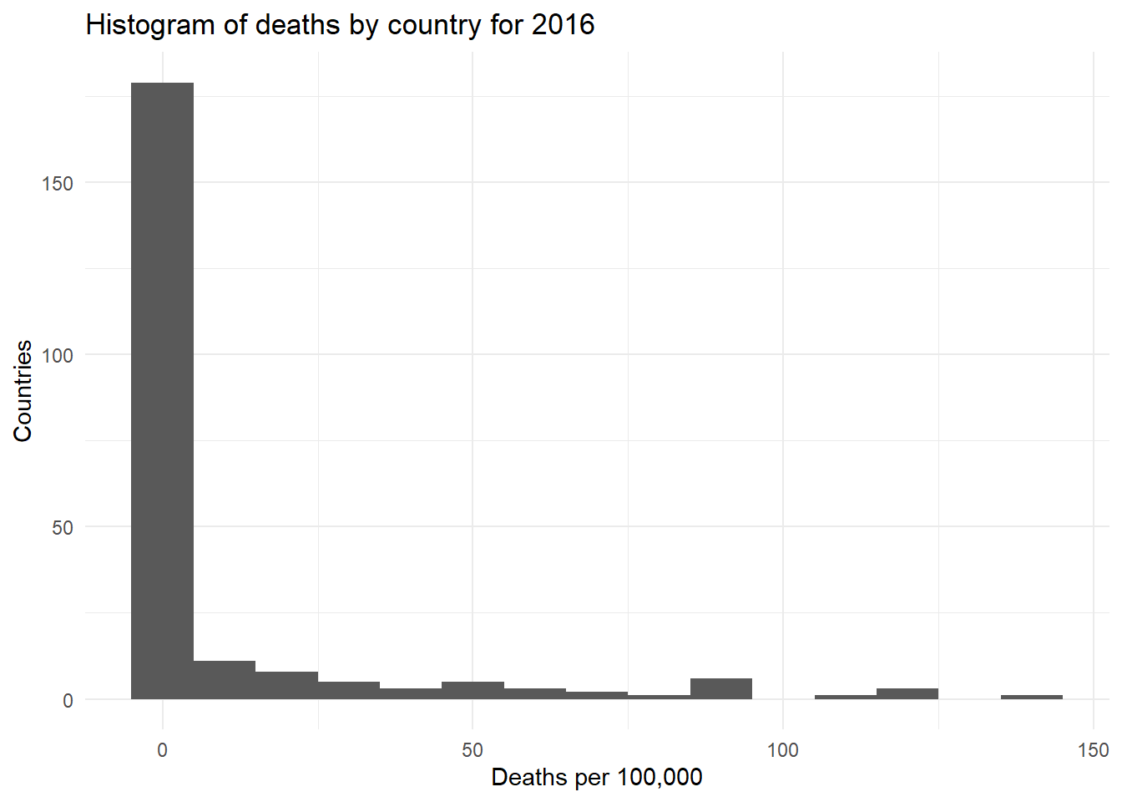
EDA
EDA – nothing fancy
Most countries have v few deaths
Deaths concentrated in a small number of countries
Density plot non-informative

Slide 3
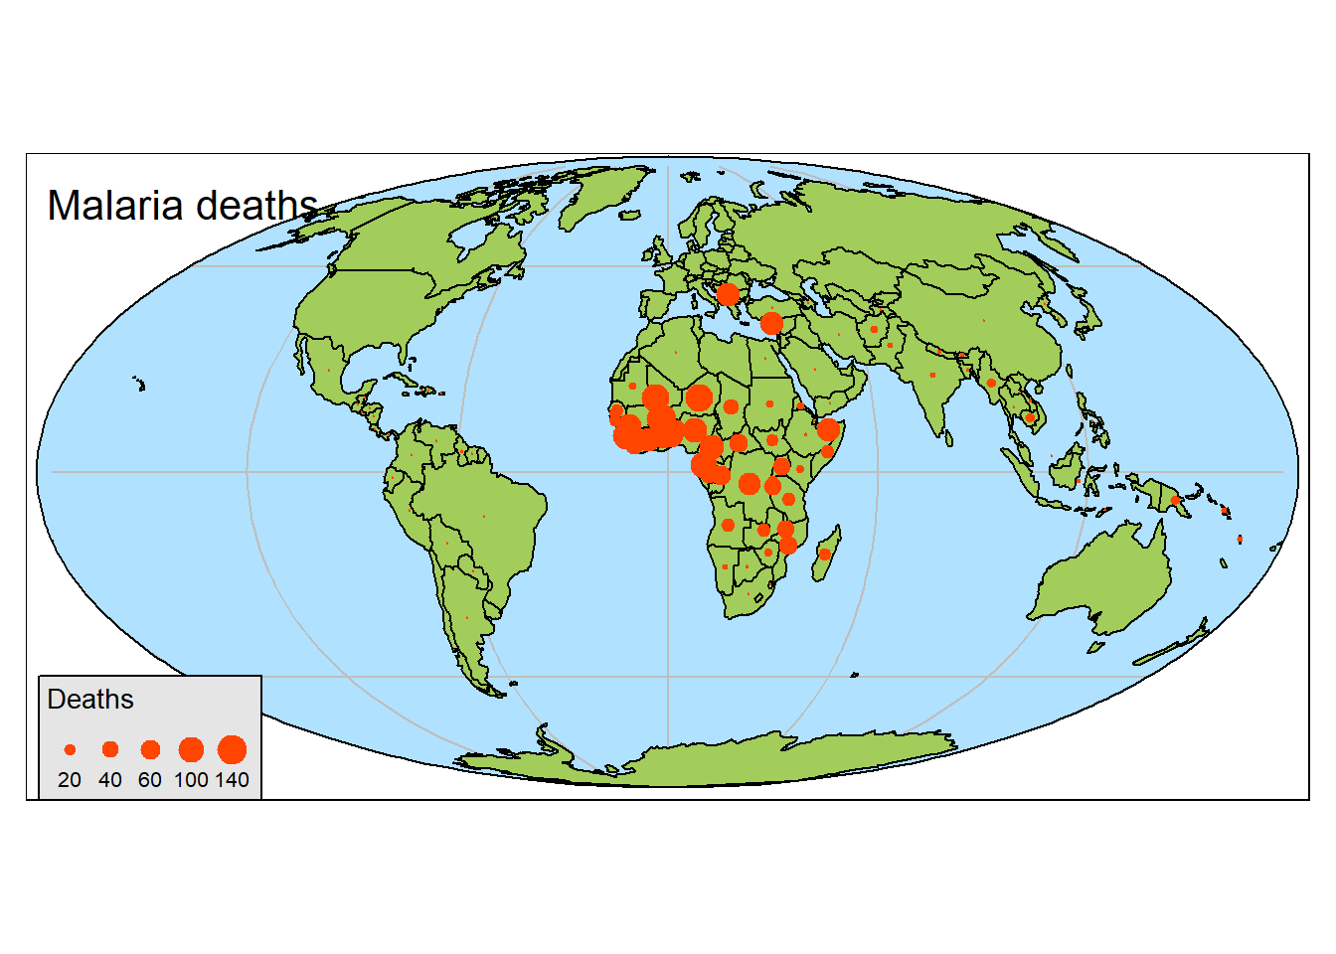
Pattern of malaria deaths 2016
Dots proportional to mortality figures
Generally tropical (mosquito habitats)
Generally Africa
Some Eastern Med
None in New World ?mosquito species
Aesthetics
Sea blue, land green
More informative
Limited junk
Much better than histogram, etc
Style - Good
Substance - clear

Slide 4
Dynamic map for 1990-2016
Dots change size by year
Generally tropical (mosquito habitats)
Generally Africa
Some Eastern Med
Could improve
Could unify country colours
Aesthetics
Sea blue, land muddled
Little information added
Limited junk
Much better than histogram, etc
Style – OK
Substance
? Not much added
? Academic bling?

